Slide 1
M4P03 Final Project
Supervised Classification Model to predict Injury Severity from Vehicle Crashes

Slide 2
Summary
Summary/Objective: This project involves building a classification model to predict the severity of injuries from vehicle crashes. The dataset contains information such as the type of weather, extent of vehicle damage, speed limit, driver fault, etc. Various machine learning models will be evaluated to determine the best model for predicting injury severity. The goal is to determine the most accurate model and deploy it for future predictions of traffic accident severity. After choosing a final model, the final model will be deployed in a Streamlit app to make a prediction.
Reference link for dataset: https://catalog.data.gov/dataset/crash-reporting-drivers-data
URLs for Streamlit app: Local URL: http://localhost:8501 Network URL: http://10.0.0.201:8501

Slide 3
Three Classification Models
Logistic Regression
Support Vector Classification (SVC)
Random Forest Classification

Slide 4
Observations from EDA
Missing values:
Route Type, Road Name, Cross-Street Name, Off-Road Description, Municipality, Related Non-Motorist, Collision Type, Weather, Surface Condition, Light , Traffic Control, Driver Substance Abuse, Non-Motorist Substance Abuse, Injury Severity, Circumstance, Driver Distracted By, Drivers License State, Vehicle Damage Extent, Vehicle First Impact Location, Vehicle Body Type, Vehicle Movement, Vehicle Going Dir, Parked Vehicle, Vehicle Make, Vehicle Model
Columns with numerical values:
The only columns with numerical values are Speed Limit, Vehicle Year, Latitude and Longitude.
The other columns have object/string values and will either need to be converted to be numerical or will be removed completely.

Slide 5
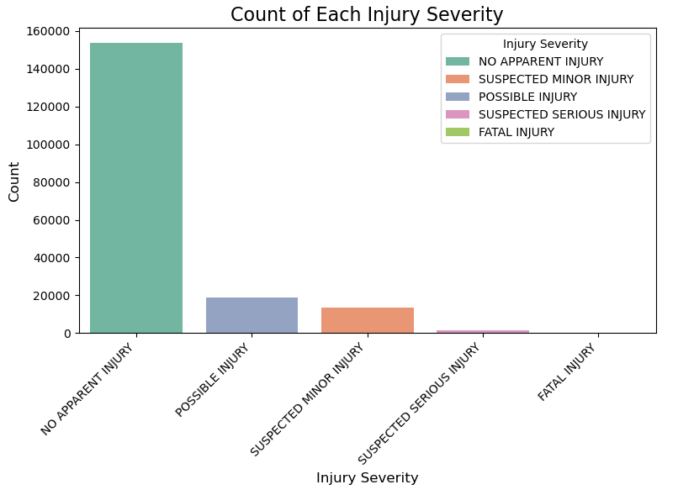
Visualization 1

Slide 6
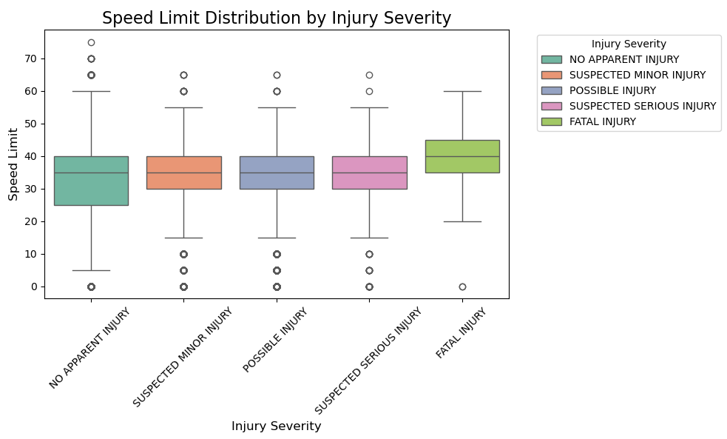
Visualization 2

Slide 7
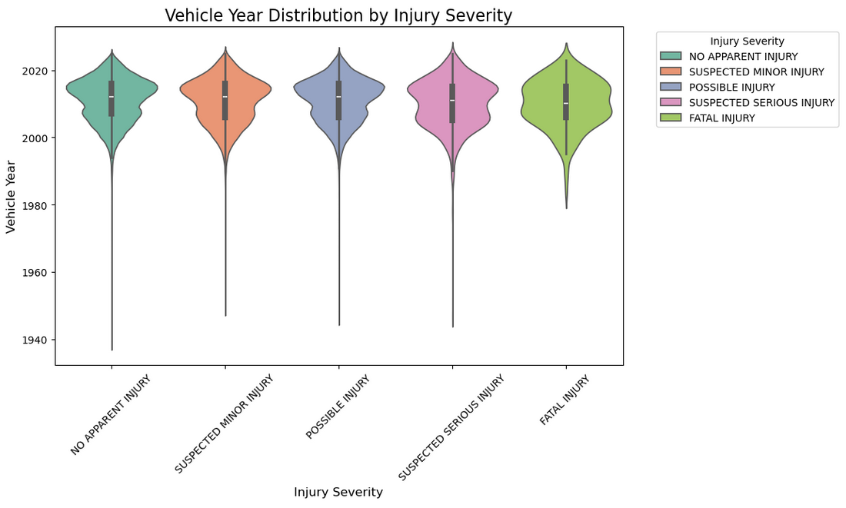
Visualization 3

Slide 8
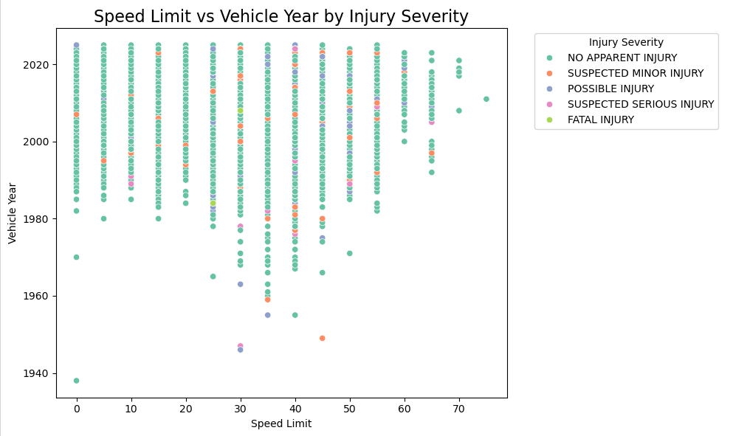
Visualization 4

Slide 9
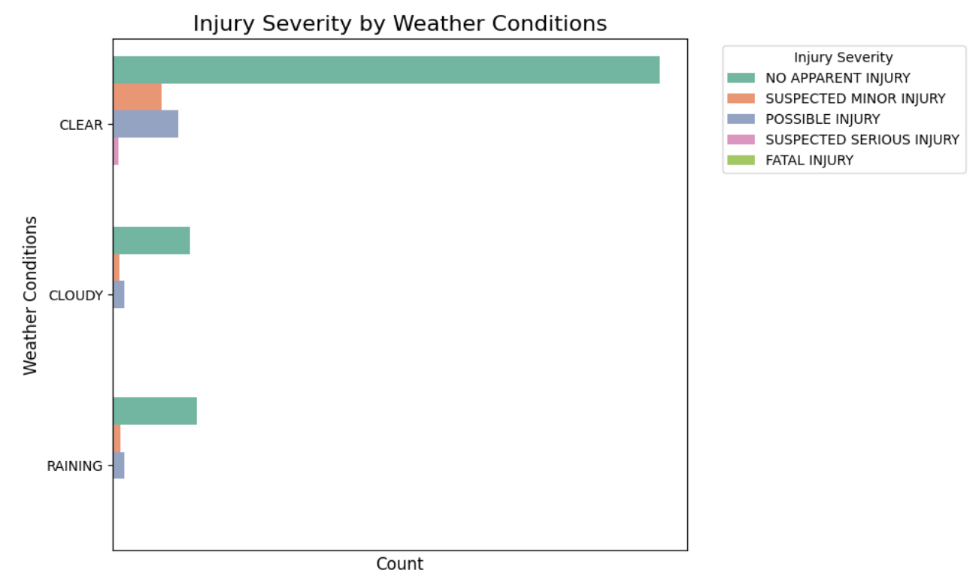
Visualization 6

Slide 10
Observations from Visualization
There is a class imbalance in the 'Injury Severity' column, with 'NO APPARENT INJURY' appearing to be over 80% of the entire dataset based off the count plot.
From the Box plot, 'FATAL INJURY' (from 'Injury Severity' column) occurs the most often at Speed Limit of 40 (mph). The other 4 catergories occur the most often at around Speed Limit of 35 (mph).
From the Violin Plot, the 'Vehicle Year' which occur the most often are vehicle years around 2010.
From the Scatter Plot, majority of crashes occured at Speed Limit of 35 (mph), ranging from Vehicle year from around 1950 to 2025.
From the Bar Plot ('Weather' and 'Injury Severity'), majority at crashes occurred during clear weather. Other crashes occurred during cloudy and raining weather.

Slide 11
Columns Removed
Columns/Features considered to be removed:
Not predictive:
Report Number, Local Case Number, Agency Name, Person ID, Vehicle ID, Off-Road Description
Rarely relevant for injury prediction:
Driverless Vehicle, Parked Vehicle
Hard to quantify effectively:
Vehicle First Impact Location
Redundant because of Lat/Long:
Location
Columns/Features considered to be removed due to too many missing values (> 80% missing values):
'Off-Road Description', 'Municipality', 'Related Non-Motorist', 'Non-Motorist Substance Abuse', 'Circumstance'

Slide 12
Columns/Features kept for Prediction:
1. Crash Circumstances:
Crash Date/Time (converted to 'Year', 'Month', 'Day', 'DayOfWeek', 'Hour', 'TimeOfDay'), Route Type, Road Name, Cross-Street Name, Weather, Surface Condition, Light, Traffic Control, Collision Type
2. Driver Behavior & Risk Factors:
Driver At Fault, Driver Substance Abuse, Non-Motorist Substance Abuse, Driver Distracted By, Drivers License State
3. Vehicle Information:
Vehicle Body Type, Vehicle Movement, Vehicle Going Dir, Speed Limit, Vehicle Damage Extent, Vehicle Year, Vehicle Make, Vehicle Model
4. Location Data:
Latitude, Longitude
5. High Correlation:
ACRS Report Type

Slide 13
Chosen Target Variable, y
'Injury Severity' will be target variable y, as the model(s) will attempt to predict the Injury Severity based off five categories.
The five categories are:
FATAL INJURY
SUSPECTED SERIOUS INJURY
SUSPECTED MINOR INJURY
POSSIBLE INJURY
NO APPARENT INJURY

Slide 14
Pre-processing and Feature Engineering
Pre-processing:
'Vehicle Year' column had numerical values (its years) from 0 to 9999, which does not make sense. 'Vehicle Year' was filtered to have years from 1938 and 2025.
Made all objects/strings upper case to avoid duplicates. Example: For "Light" column, there's 'DAYLIGHT' and 'Daylight'. Made all 'daylight' values to 'DAYLIGHT’.
Filled missing values with the mode.
Pre-processing and Feature Engineering on 'Crash Date/Time’:
Pre-processing: Converting 'Crash Date/Time' into a datetime format. (ex:05/27/2021 07:40:00 PM)
Feature Engineering: Creating new features like 'Year', 'Month', 'Day', 'DayOfWeek', 'Hour', and 'TimeOfDay' from the datetime data.

Slide 15
Feature Engineering : Binary Encoding and Mapping Values (Converting to Numerical Values )
Binary encoding was used to encode all features (except 'Injury Severity’) which had object/string values, to be converted to be numerical values.
Mapped 'Injury Severity' categorical values to the following:
'FATAL INJURY’: 4
'SUSPECTED SERIOUS INJURY’: 3
'SUSPECTED MINOR INJURY’: 2
'POSSIBLE INJURY’: 1
'NO APPARENT INJURY’: 0

Slide 16
Top 20 Correlations
Feature | Correlation
Injury Severity | 1
ACRS Report Type_0 | 0.568206
Vehicle Damage Extent_1 | 0.194687
Speed Limit | 0.110278
Vehicle Damage Extent_2 | 0.07939
Driver At Fault_1 | 0.072794
Latitude | 0.060372
Vehicle Movement_2 | 0.054615
Traffic Control_3 | 0.044948
Vehicle Body Type_1 | 0.040948
Cross-Street Name_11 | 0.032687
Cross-Street Name_3 | 0.032372
Cross-Street Name_9 | 0.030143
Cross-Street Name_6 | 0.030088
Road Name_8 | 0.029478
Vehicle Model_9 | 0.027482
Cross-Street Name_10 | 0.02719
Cross-Street Name_4 | 0.027115
Collision Type_4 | 0.026262
Cross-Street Name_5 | 0.025597
Observations regarding the top 20 correlations with 'Injury Severity’:
Features which involve 'ACRS Report Type', 'Vehicle Damage Extent', 'Speed Limit', and 'Driver At Fault' are among the highest correlations with 'Injury Severity'.

Slide 17
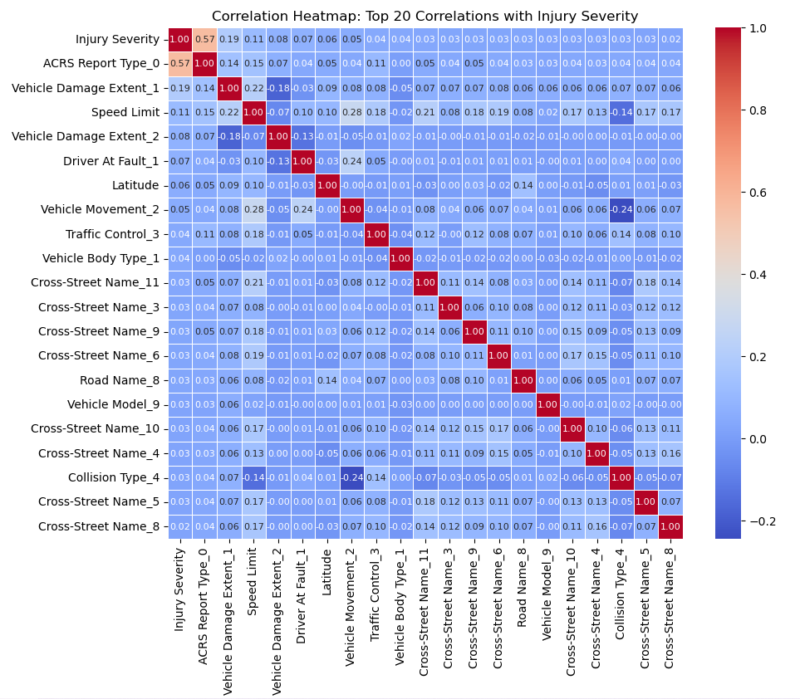
Correlation Heatmap

Slide 18
Class Weights
The following Class Weights was be used to handle class imbalance:
class_weights = {0: 1, 1: 12, 2: 15, 3: 20, 4: 19}
Higher class weight was given to POSSIBLE INJURY (class 1), SUSPECTED MINOR INJURY (class 2) and SUSPECTED SERIOUS INJURY (class 3) as these three categories get the lowest metrics from the classification reports (based on previous model fitting/training).
Higher class weight was given to FATAL INJURY (class 4) due to having the lowest number entries.

Slide 19
Scaling (StandardScaler )
Logistic Regression has scaled data:
Logistic Regression should have scaled data because it uses optimization methods to find the best solution, and if features are on different scales, it can slow down the process.
Support Vector Classification (SVC) has scaled data:
SVC (Support Vector Classification) is sensitive to the scale of the input features because it relies on calculating distances between data points.
Random Forest Classification not requiring scaling:
Random Forest does not require data to be scaled because it builds decision trees that split data based on feature values, which are not affected by the scale of the features.

Slide 20
GridSearchCV, Model Training
GridSearchCV was used to find the best hypermeters (in param_grid) for each model.
GridSearchCV arguments and parameters used:
cv=5
scoring='accuracy’
Each model was being assigned class_weights = {0: 1, 1: 12, 2: 15, 3: 20, 4: 19}

Slide 21
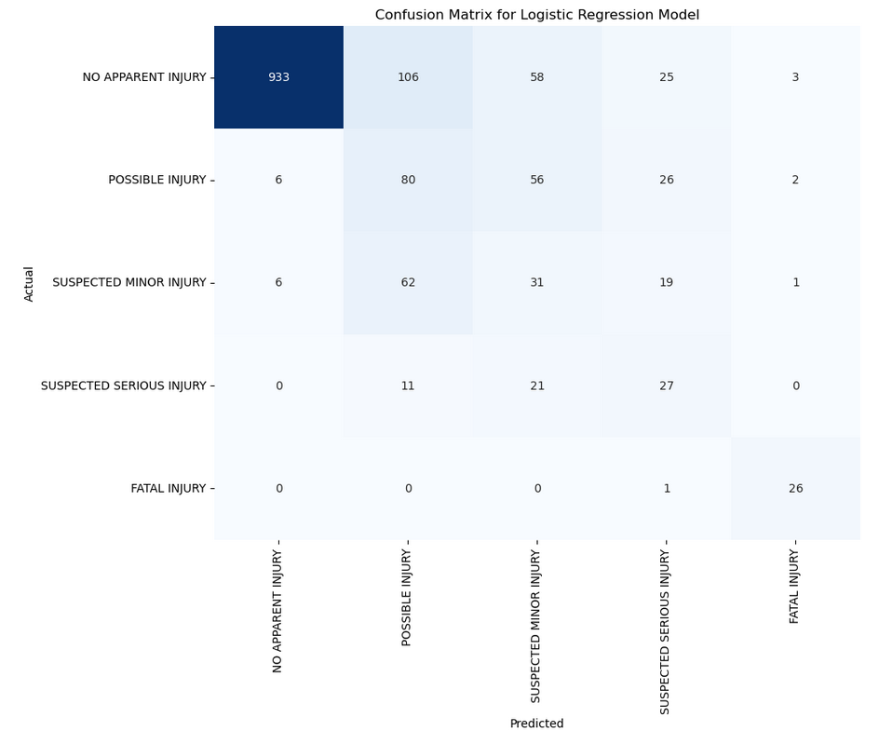
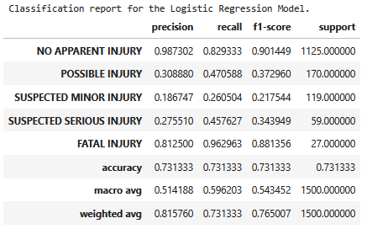
Model 1: Logistic Regression
Best parameters: {'C': 1.0, 'l1_ratio': 0.0, 'penalty': 'l2', 'solver': 'liblinear'}

Slide 22
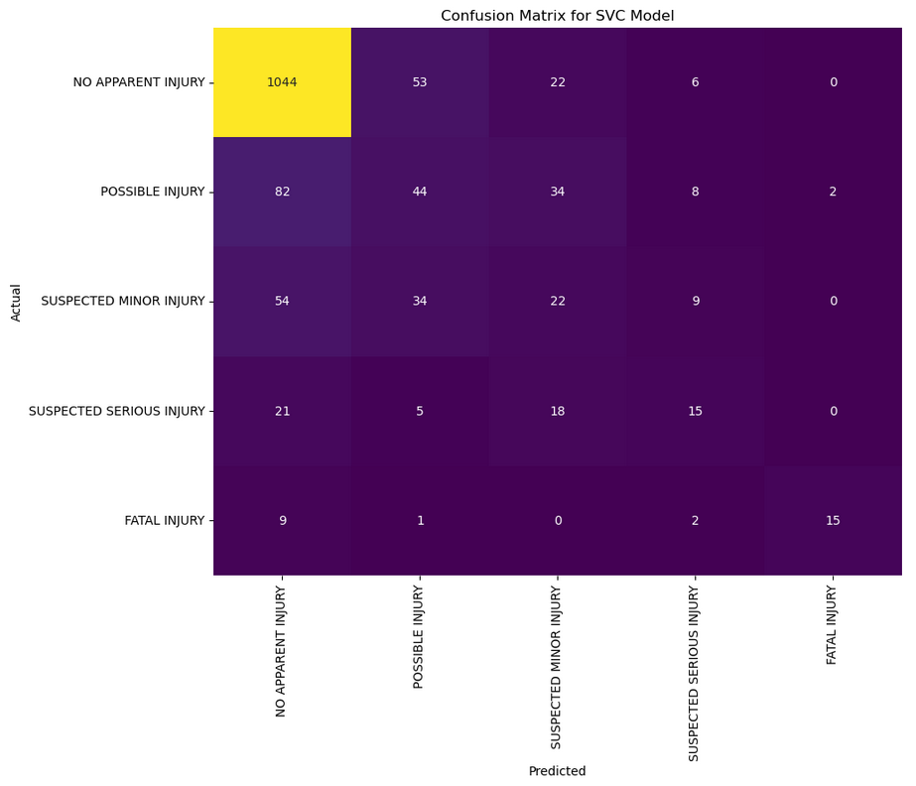
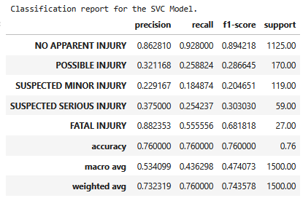
Model 2: Support Vector Classification (SVC)
Best hyperparameters: {'C': 10, 'gamma': 'scale', 'kernel': 'rbf'}

Slide 23
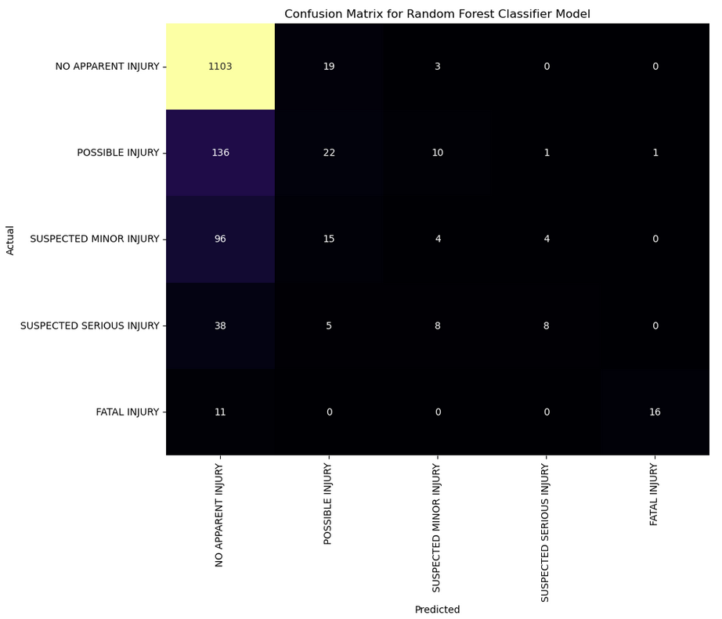
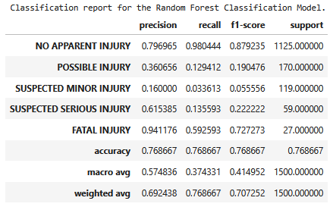
Model 3: Random Forest Classification
Best parameters: {'bootstrap': True, 'max_depth': None, 'max_features': 'sqrt', 'n_estimators': 100}

Slide 24
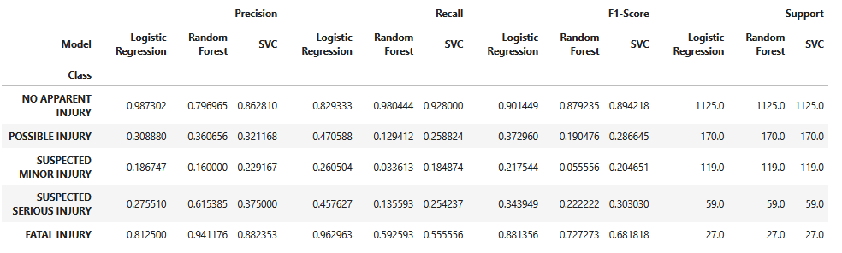

Evaluation for all 3 Models

Slide 25
Classification Reports Evaluation Comments
Noticed that the Precision, Recall and F1-Score are quite low for POSSIBLE INJURY (Class 1), SUSPECTED MINOR INJURY (Class 2) and SUSPECTED SERIOUS INJURY (Class 3).
Noticed that the Precision, Recall and F1-Score are higher for NO APPARENT INJURY (Class 0) and FATAL INJURY (Class 4).
Despite including class weights, the metrics for POSSIBLE INJURY (Class 1), SUSPECTED MINOR INJURY (Class 2) and SUSPECTED SERIOUS INJURY (Class 3) were still low. As a future possible improvement, consider using higher class weights for these classes.
Random Forest Classification has the highest accuracy.
--------------------------------------------------------------------------------------------------------------------------------------------------------------------
Final Chosen Model
The Random Forest Classification was chosen as the Final Model for having the highest accuracy.

Slide 26
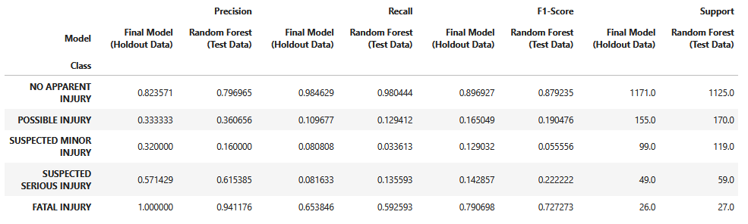

Evaluation with Test Data and Holdout Data (Final Model: Random Forest Classification)

Slide 27
Holdout Data Comparison Comments
With Cross-validation (with GridsearchCV), the metric results (Precision, Recall and F1-Score) of the testing data for Random Forest Classification is similar to the metric results of the holdout data for Random Forest Classification, with the exception of 'SUSPECTED MINOR INJURY' where the metrics were higher with the holdout data when comparing with the test data.
With Cross-validation (with GridsearchCV), the accuracy of the testing data for Random Forest Classification is almost similar to the accuracy of the holdout data for Random Forest Classification, with the holdout data having slightly higher accuracy over the test data.

Slide 28
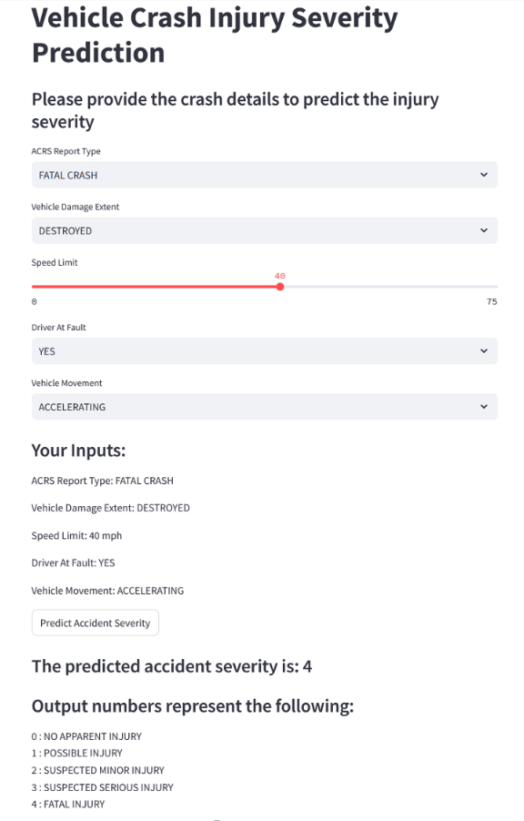
Saved Final Model for Deployment (Streamlit App)
Final Model (Random Forest Classification) was saved as a JOBLIB file.
Final Model was deployed and imported to make prediction on a Streamlit app.
Inputs created for users to make prediction:
ACRS Report Type
Vehicle Damage Extent
Speed Limit
Driver At Fault
Vehicle Movement
URLs for Streamlit app: Local URL: http://localhost:8501 Network URL: http://10.0.0.201:8501

Slide 29
Conclusion
In conclusion, three models were tested: Logistic Regression, Support Vector Classification (SVC) and Random Forest Classification.
Of the three models, the Random Forest Classification model had the best performance as it had the highest accuracy.
The Random Forest Classification model was chosen as the final model.
For chosen features: features such as Weather, Driver At Fault, Vehicle Damage Extent, Speed Limit, ACRS Report Type, etc. were chosen as they could influence the Injury Severity.
The features underwent various preprocessing and feature engineering techniques to enhance their suitability for model prediction.
Cross-validation (with GridSearchCV) was used as a validation scheme. Cross-validation was used to evaluate the holdout data for the final model, and has almost similar results/metrics with the test data.
Binary Encoder was used was used on all applicable features (which were originally objects/strings) to convert their values to be numerical.
Mapping was used for 'Injury Severity' to convert their values to be numerical.
Scaling was not applied on the data for the final model (Random Forest Classification), as it was not necessary for the Random Forest model.
After experimentation, the Random Forest Classification Model was able to provide a prediction of the Injury Severity.
The final model ('M4P03_final_model.joblib') was used for deployment as a Streamlit app and was able to make a prediction.

Slide 30
End
Thank you

